Slide 1
ECE 4300: Group J
Hector Arvizu, Myriam Boutros, Chanel Williams, Diego Ramon

Slide 2
OUR PURPOSE
The importance of utilizing YOLO modeling for the detection of uranium in nuclear security applications lies in the critical need for swift and accurate identification of radioactive materials to prevent potential threats and ensure public safety.
This speed is crucial for timely responses to potential threats, allowing security personnel to take appropriate actions swiftly.
This is essential to minimize false positives and negatives, ensuring that security systems provide reliable information for decision-making.
This adaptability enhances the model's performance in real-world applications where conditions may vary.
This enhances our ability to respond effectively to potential threats and protect public safety.

Slide 3
Paddle Detection Overview
Paddle Detection is a development kit that offers high performance on object detection, face recognition, and multi-object tracking.
With access to 30 model algorithms, and over 300 pre-trained models, Paddle Detection is simple to use in order to build and try various detection models.
Due to its high performance core, this kit is able to perform the following tasks:
PCB Defect Detection
Visitor Flow Statistics
Vehicle Flow Statistics
Electrical Bike Detection (and more)

Slide 4
PP - YOLO
Paddle Paddle You Only Look Once
Three part system :
Backbone - convolution neural network, pre-trained ResNet50-vd
Detection Neck - Feature Pyramid Network created by combining/mixing
ConvNet
Detection Head - Predictions and bounding box to object

Slide 5
PP YOLO CONT.
Many pre-trained models such as object detection, instance segmentation and face detection.
Modular Designs allowing for different pipelines
End - to End methods for data augmentation and constructions

Slide 6
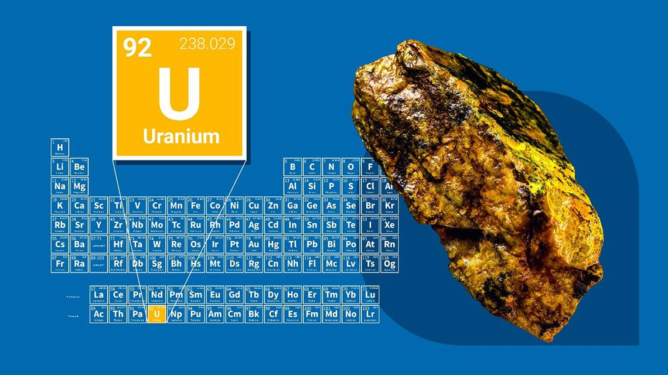
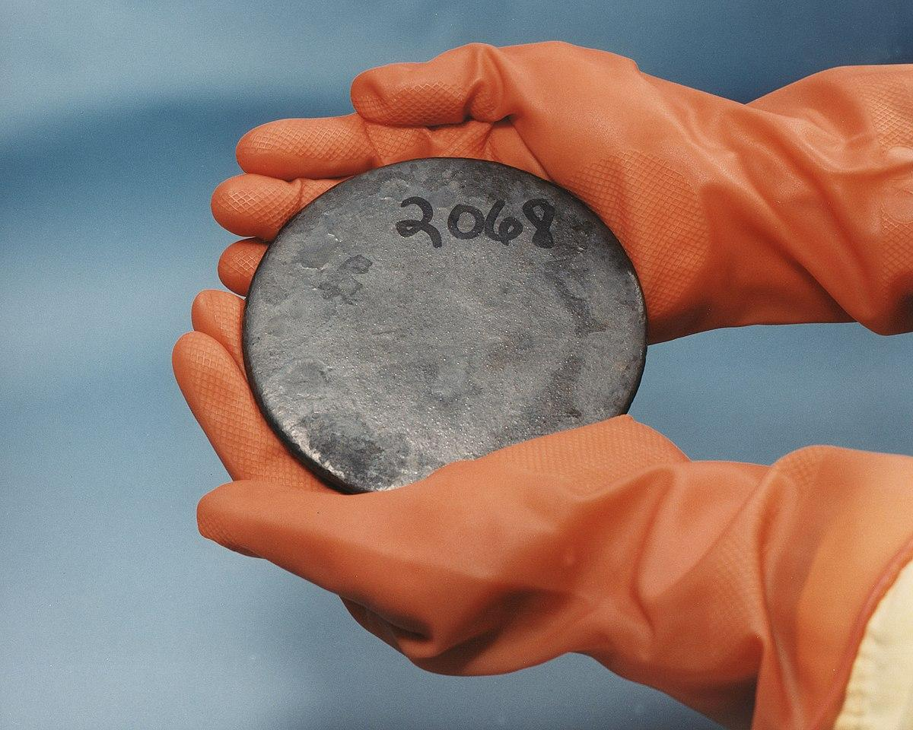
Desired Outcome
Ability to properly detect minerals such as uranium.

Slide 7
Progress
8/30: Group formed.
9/01: Viewed several project ideas.
9/08: Introduced to Paddle Detection.
9/12: Paddle Detection code run through.
9/25: Put together powerpoint.
9/27: Powerpoint presentation.
10/08: Install the paddle paddle program to test and record results.
10/16: Record errors and anything that didn't work.
10/16: Progress Presentation.

Slide 8
What’s done
We have most of the code and we are just editing the code to fulfill our requirements and putting final touches. We finalized all of our requirements for our software detection. Testing needs to be done using multiple different stations to acquire benchmarks.

Slide 9
Working/Not Working
The code needs to be properly executed and implemented into a working machine. We have to make sure that the percent of error is at its lowest so we have to do more testing and modify our code. Currently we don't have as much resources as we did before therefore since we don't know exactly what could be changed to better improve our project for our purpose so it’s a lot of trial and error.

Slide 10
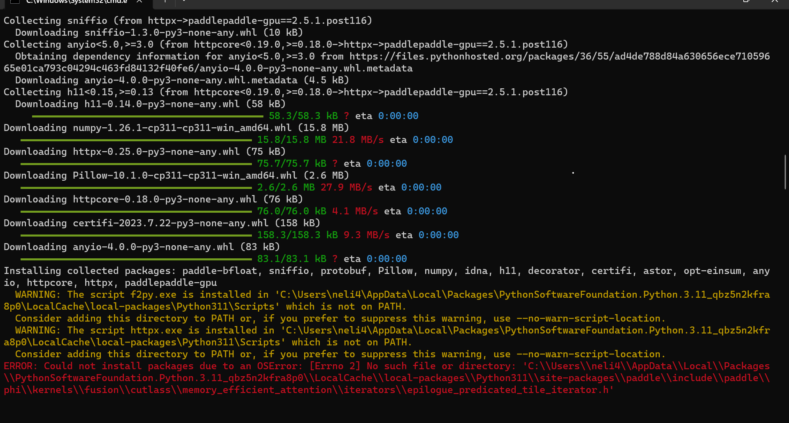
Adjustments
We change the version were using to v5 instead of paddlepaddle since it didn't work out as we thought it would. We tried to install it but we ran into a lot of problems with this version too like OSerror:no File or directory found and that we ran out of space on any device we used: such as virtual box, putty, and window terminal.

Slide 11
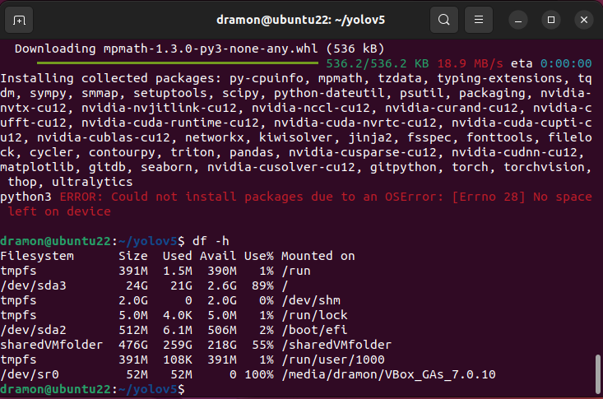

Slide 12
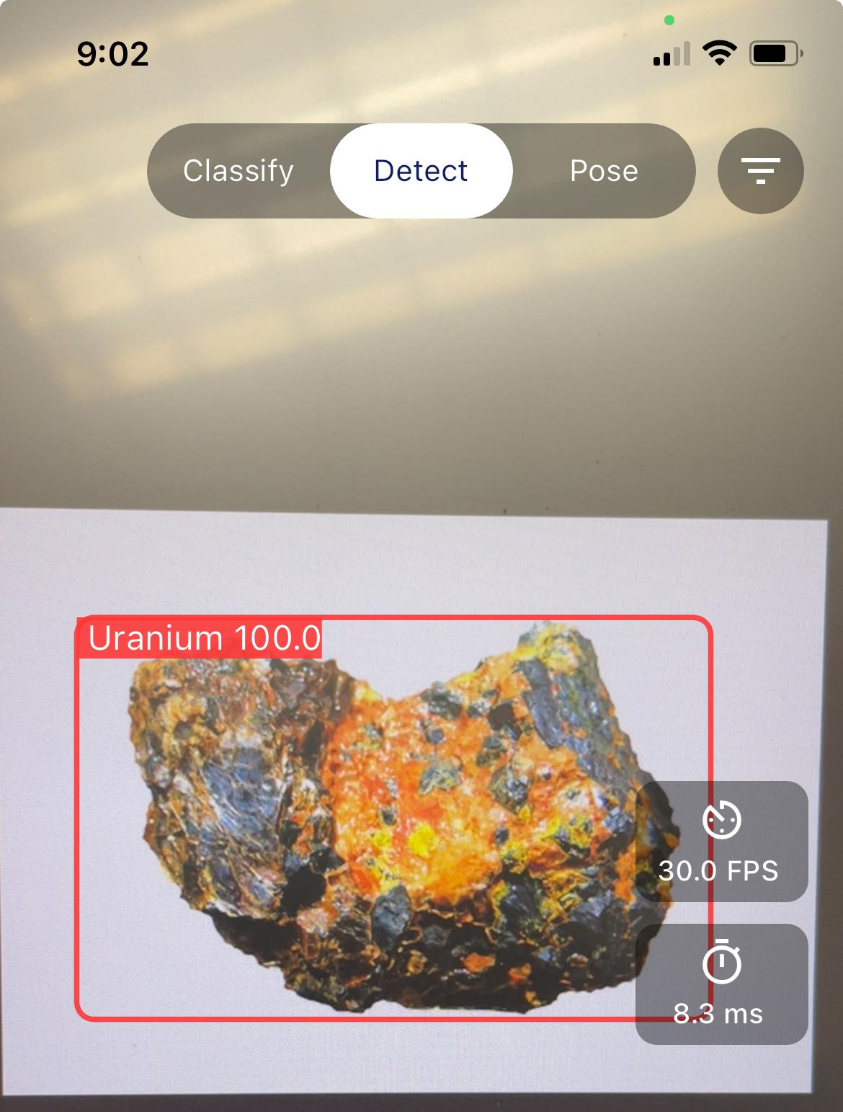
We’ve decided to use yolov8 OCR on ultralytics to try to train the machine to detect uranium from uploaded pictures. That will give us the code to detect uranium, then we could put in the program.

Slide 13
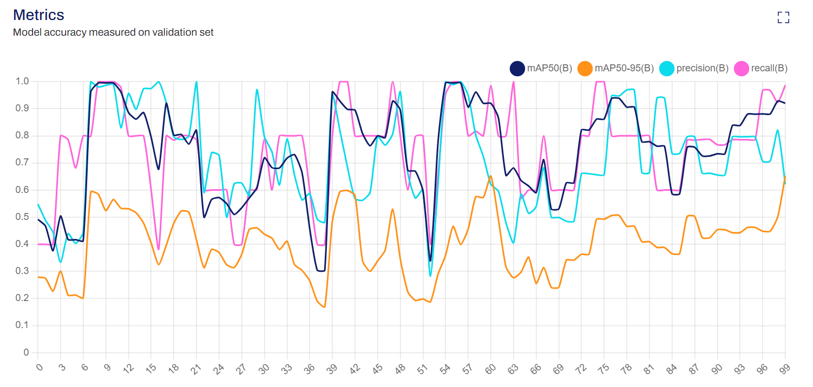
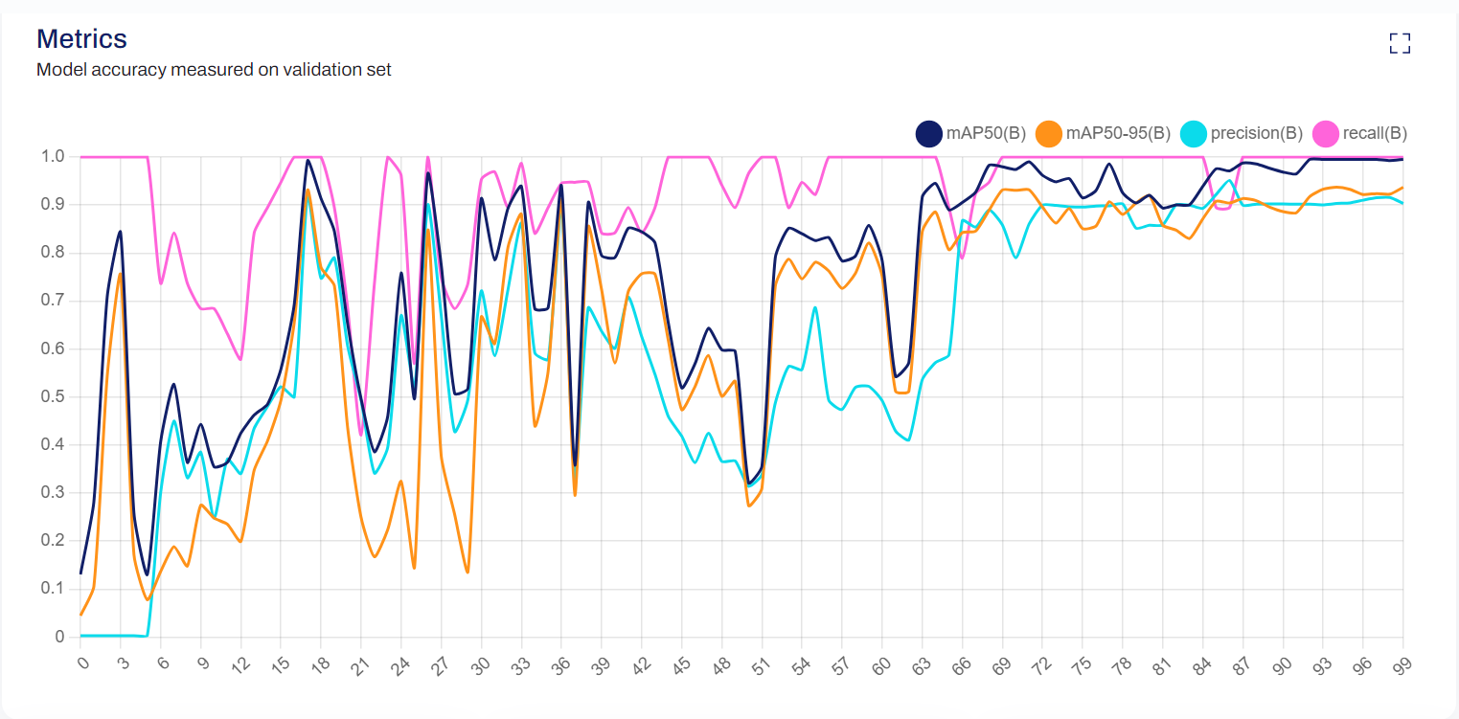
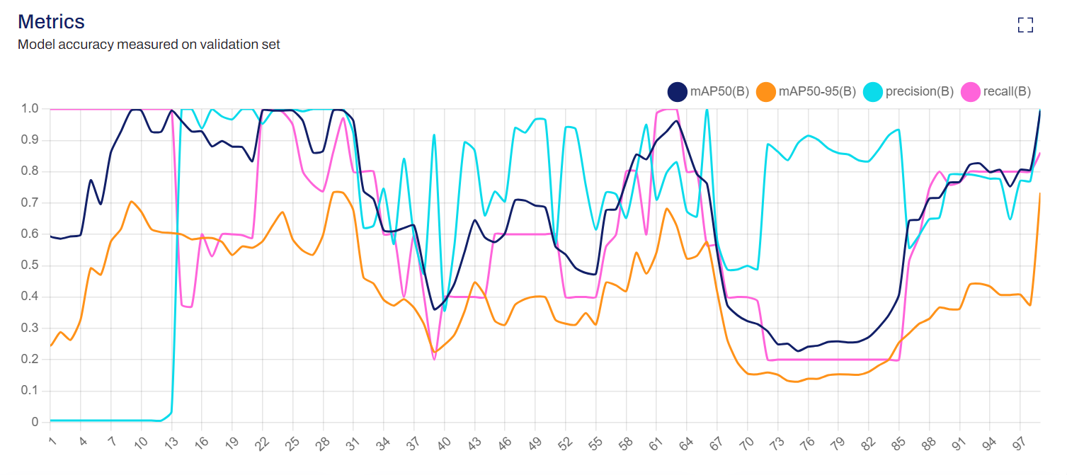
Our Results
Figure 1: Model accuracy measured on validation 3rd set
Figure 2: Model accuracy measured on validation 2nd set
Figure 3: Model accuracy measured on validation 1st set

